Slide 1


Minor Project - 1
Title: SharpView – Low Light Image Enhancement using C++
Presented by:
R2142220936 – Sagar Thapliyal
R2142221156 – Aviral Khanna
R2142220937 – Saksham Siwach
R2142220447 – Arshdeep Kaur
Mentored by:
Mrs. Gaytri

Slide 2
Content
Introduction
Literature Review
Objectives
Methodology
References

Slide 3
Introduction
Technical Concepts (Algorithms) used:
Image Processing – We will be first collecting low light images from different online as well as physical sources. As we are aware that, normally, the images exist in either JPEG format or PNG format, so we will be processing the images to convert them into PPM format. Then, after enhancing the image, we will be again converting the PPM images to JPEG format.
Image Enhancement – We will be starting this with smoothening, which will reduce excessive Gaussian Noise from the image. Then, renowned techniques of image enhancement like CLAHE(Contrast Limited Adaptive Histogram Equalization) and Gamma Correction, will be implemented, parallelly on a single image, to enhance contrast and brightness of the image. This will be followed by Shape-Adaptive Discrete Wavelet Transformation, for the fusion of images to a single one. Then, we will be using Gray-World Color Correction and Balance Adjustment technique to enhance the color intensities inside the image. To produce the final enhanced output of the image, we will be first sharpening the image and finally using Inverse Shape-Adaptive Discrete Wavelet Transformation.
Notes:
Why PPM Format? – Must be explained. As, these are uncompressed format of images, which holds raw data of the image i.e. lossless compression, suitable for fast processing and easy debugging.

Slide 4
Motivation
Real-Life Use Case – Can be used to enhance images captured at night or in low-light conditions, which can be very beneficial in terms of safety and security.
For Low-End Devices – As it uses no external libraries or dependencies, it has very less overhead on the machine and eventually it has a fast processing pipeline. As a result, can also be used easily on a low end device.
Deeper Understanding of Image Enhancement Concepts – As we are implementing each and every technique from scratch, we will gradually develop a greater understanding of each technique and it would benefit us in longer run to work on other image related projects.
Problem Statement
Many digital images, particularly those captured in suboptimal conditions such as low-light, suffer from quality issues such as low brightness, inadequate contrast, noise, and blurriness. Such degraded images are less useful for analysis or viewing. While there are existing solutions and number of applications to enhance images, they often rely on external libraries, which may not be practical for lightweight applications or environments with limited resources.

Slide 5
Area of application
This project can be beneficial in multiple areas like:
Surveillance Systems: In enhancing low-light images captured by security cameras to improve visibility and ultimately contributing in increased safety.
Medical Imaging: In enhancing images for better diagnosis and analysis which are blurry/ not clear due to some reasons or captured under low-light conditions.
Mobile Photography: Improving quality of the pictures that are distorted or captured in poor lighting. Especially useful for low-end devices.
Forensics: Enhancing pictures from crime scenes, which have been taken in dim light conditions, ultimately revealing more details.
Remote Sensing: Improving images captured from drones or satellites during night operations.
Dataset and input format
Dataset: ExDark Dataset, which is the collection of low-light images from various sources, is being used during the testing phase of the project. Otherwise, real-time image data will be used.
Input Format: The input images should be in the PPM format, containing raw RGB pixel data, which can be processed directly by the C++ program without using external libraries.

Slide 6
Literature Review
Cite Related work
The topic of the study is concerned with the research of various techniques of image enhancement at large, with focus on directions that are intended to increase contrast and visibility in marginal lighting conditions. It was seen that hand crafted methods along with learning-based methods have been employed for its realization. There is poor agreement when using conventional techniques, and methods of averaging are significantly inferior to novel approaches developed to overcome these challenges. A wide range of research work has focused on reconstructing histogram equalization (HE) which is dominant for enhancing image contrast. Global Histogram Equalization (GHE) has been widely applied, but it results in the over-amplification of high frequency gray level resulting in low frequency level contrast reduction. Local Histogram Equalization (LHE) is better than the global approach in this regard by applying the histogram equalization to smaller sections of the image at a time but this leads to problems associated with Practical Issues including noise and over enhancement [1].
DHE divides the image histogram into sub-histograms which do not contain any large components. High dynamic sub-histograms are assigned dynamic range of gray levels depending on its input and cumulative distribution function. This approach prevents small features from being hidden and leads to moderate amplifiers of contrast across the image which means enhancement without large side effects [1]. DHE has been adopted in medical imaging mainly in the process of making the X-ray images to reveal the bone structure and possible fractures clearly. It assists the radiologists to perform their work more effectively by coming up with more enhanced images that enhance the chances of arriving at accurate diagnosis results. HS changes the histogram to the required density which is not easy to find out for each image. DHS goes further than this by constructing the specified histogram from the input image while at the same time maintaining some of the original histogram characteristics in addition to giving a moderate degree of enhanced histogram [1].

Slide 7
In satellite image processing, DHS has been applied to the image obtained at night or early morning where the illumination surrounding objects is least favorable. In this regard, DHS is particularly useful in that it minimizes the changes applied to the actual histogram characteristics that can affect the general landscape at the base, albeit improving the definition of such objects as water and city in the process[5].
RMSHE has enhanced feature over the methods such as the bi-histogram equalization (BBHE). It recursively divides the histogram for the bestiality of contrast but sometimes it hampers or adds some noise or artifacts [1].
Images captured by digital cameras are vulnerable to quality degradations due to non-ideal illumination conditions such as dominated lighting source colors, where images so obtained may not faithfully reproduce the scene chromatics accurately. While it is a complicated process to control the scene illumination, color correction used as a post-processing procedure, is becoming an attractive solution. This research has developed an approach for color correction based on a modified implementation of the gray world assumption. The image color is adjusted by employing a gamma correction to satisfy the gray world assumption and avoid color saturation as encountered in the conventional approach. In order to further improve the image visual quality, an intensity preservation criterion is adopted as an additional means to produce the resultant image. With the normalization of intensity in accordance with the original image, an enhanced image both in color and intensity, is finally obtained. A collection of color images are used in an experiment to verify the proposed algorithm. Results have indicated that the proposed method is effective in producing enhanced images in the context of color enhancements[2].

Slide 8
The paper by W. Kim categorizes these techniques into two broad groups: classic feature-based and learning-based methods of approach on the one hand. These methods use statistical models, pixel intensity histograms and the Retinex theory to produce enhanced images. They have been beneficial in numerous situations but they generally have problems with issues related to smooth, spatially gradated, lighting changes which yield inconsistent levels of improvement across an image [3].
The Retinex-based techniques have also been applied in security surveillance and other systems to improve the image quality that is usually captured during the night. These methods assisted in increasing brightness for chances of recognizing threats or suspects in recorded videos. Recent deep learning methods have produced significant performance enhancements for low light image recovery since they directly learn from low illuminance and well-illuminated images. However, these methods are had a learning bias issue since they are highly dependent on characteristics of the training data. To avoid this, the use of unsupervised and zero-reference models is encouraged, and it is believed these could improve the images without necessarily requiring paired training data, and this would reduce learning bias, thus improving generalization [3].
One of the applications of learning-based methods has been applied in automotive systems, especially in improving the feed from night vision cameras. This makes it easy to identify pedestrians, animals and other cars on the road especially during the night hence improving and enhancing safety. A new approach adopted in the recent CVPRW 2024 paper, called DiffLight, combines the use of a diffusion model in the removal of noises and the use of an end-to-end UNet Transformer in the enhancement of low light images. This also incorporates new work like the Light Full-Former that comes with a newer Light Full-Attention (LFA) module and another advancement known as the Progressive Patch Fusion (PPF) technique which helps to reduce block artifacts and perform remarkably better than the prior models particularly in low-lighting scenarios [4].

Slide 9




SWOT Analysis:
S
W
O
T
STRENGTHS
WEAKNESSES
OPPORTUNITIES
THREATS
Machine Independent
Versatility
Less Overhead on Machine
Accurate Computation
Error Prone
Tough Parameter Tuning
High Complexity
Basic UI
Improvements via Feedback Loops
Potential for Real-Time Applications
Educational Value
Competition with other libraries
Maintenance Challenge
Technology Shifts

Slide 10
Objective
Main Objective
To design and implement a lightweight and robust C++ program that performs a variety of image enhancement techniques, which aims to improve the visual quality of degraded or distorted images(containing noise/ blur) captured in low-light conditions, that too without using any external libraries, and ensuring it is suitable for low-end devices (resource-constrained systems).

Slide 11
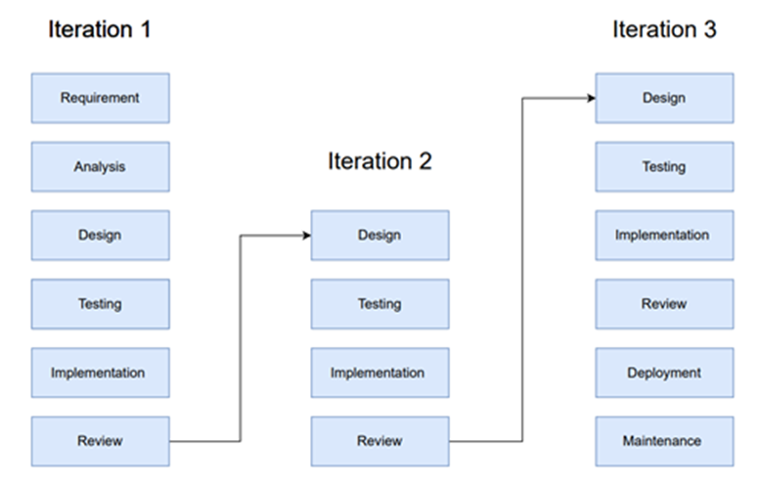
Methodology
Reference Software model
We will be using the Iterative Model to implement our project. The iterative method begins with a basic implementation of a limited set of software requirements in the iterative model, then repeatedly improves the evolving versions until the entire system is built and prepared for deployment.

Slide 12
Steps
Initial Noise Reduction: In this case to extract the region of interest we will be using renowned smoothing filter, Gaussian filter to remove noise from the image.
CLAHE & Gamma Correction: CLAHE will be used to readjust local contrast while we shall use Gamma Correction to further modify brightness.
SA-DWT Fusion: For merging these improvements, we have used the Shape-Adaptive Wavelet Transform to perform the task of merging the effects of CLAHE and Gamma Correction.
Gray World Color Correction: For color balance, the channels are tweaked so as to equalize color means, thus creating a naturally colored image.
Sharpening: To improve the image brightness we will be applying the sharpening filters to improve edges and details.
Inverse SA-DWT: To reconstruct our image, we will add all the wavelet enhancements into one image in order to achieve our intended goal.
Iterative Refinement: Last but another enhancement technique that we have adopted is the utilization of Quality metrics (PSNR, SSIM) to enhance the quality of the image to better results.

Slide 13
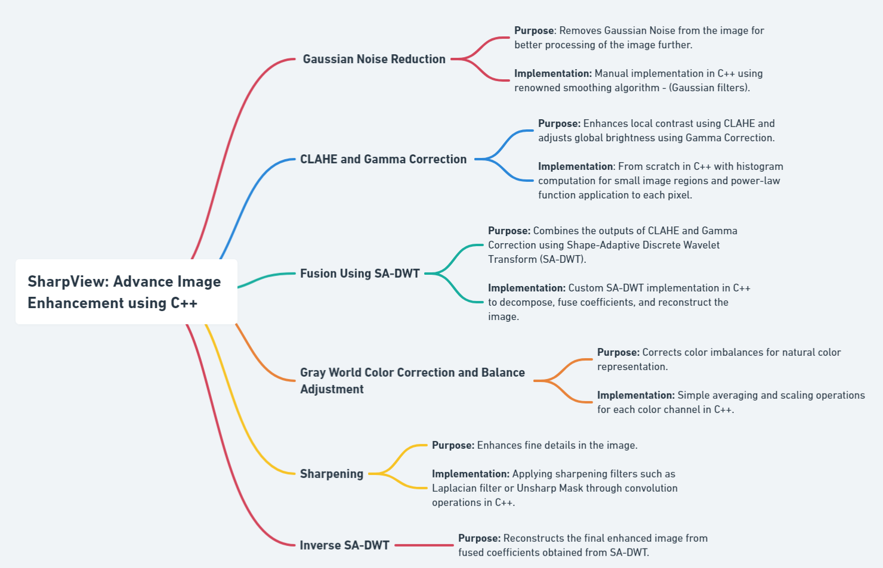

Slide 14
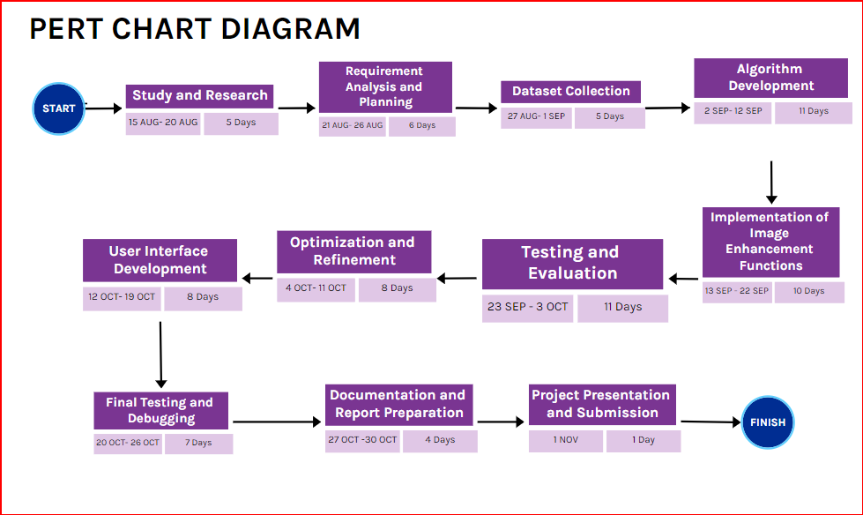
Timeline

Slide 15
Reference
List of cited papers
[1] A Dynamic Histogram Equalization for Image Contrast Enhancement M. Abdullah-Al-Wadud, Md. Hasanul Kabir, M. Ali Akber Dewan, and Oksam Chae, Member, IEEE
[2] Gray World based Color Correction and Intensity Preservation for Image Enhancement N.M. Kwoka, D. Wanga, X. Jiab, S.Y. Chenc, G. Fangd and Q.P. Hae aSchool of Mechanical and Manufacturing Engineering The University of New South Wales, Australia bSchool of Information Technology and Electrical Engineering The University of New South Wales, Australia cCollege of Computer Science Zhejiang University of Technology, 310023 Hangzhou, China dSchool of Engineering University of Western Sydney, Australia eSchool of Electrical, Mechanical and Mechatronic Systems University of Technology Sydney, Australia
[3] Low-Light Image Enhancement: A Comparative Review and Prospects WONJUN KIM , (Member, IEEE) Department of Electrical and Electronics Engineering, Konkuk University, Seoul 05029, South Korea
[4] DiffLight: Integrating Content and Detail for Low-light Image Enhancement Yixu Feng1 Shuo Hou1 Haotian Lin1 YuZhu1 PengWu1 WeiDong2 Jinqiu Sun1 Qingsen Yan1† Yanning Zhang1 1Northwestern Polytechnical University 2Xi’an University of Architecture and Technology
[5] M2Trans: Multi-Modal Regularized Coarse-to-Fine Transformer for Ultrasound Image Super-Resolution Zhangkai Ni, Member, IEEE, Runyu Xiao, Wenhan Yang, Member, IEEE, Hanli Wang, Senior Member, IEEE, Zhihua Wang, Lihua Xiang, and Liping Sun

Slide 16
Thank You

